Slide 2
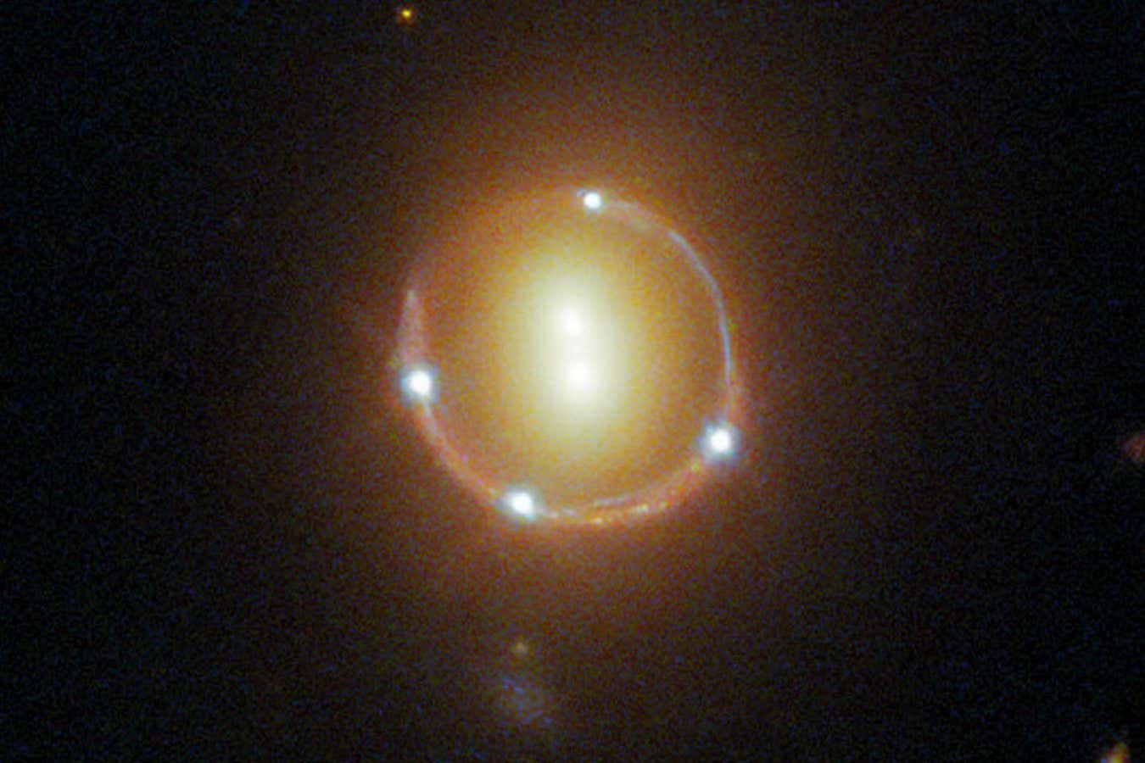

Slide 3

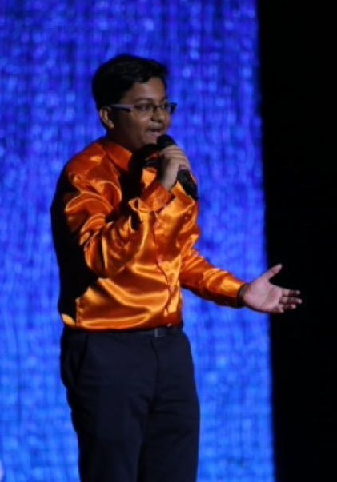

Slide 4

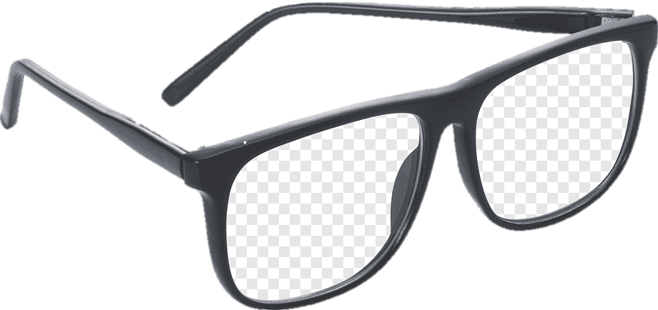
LENS
Magnification
Make Image Clearer

Slide 5
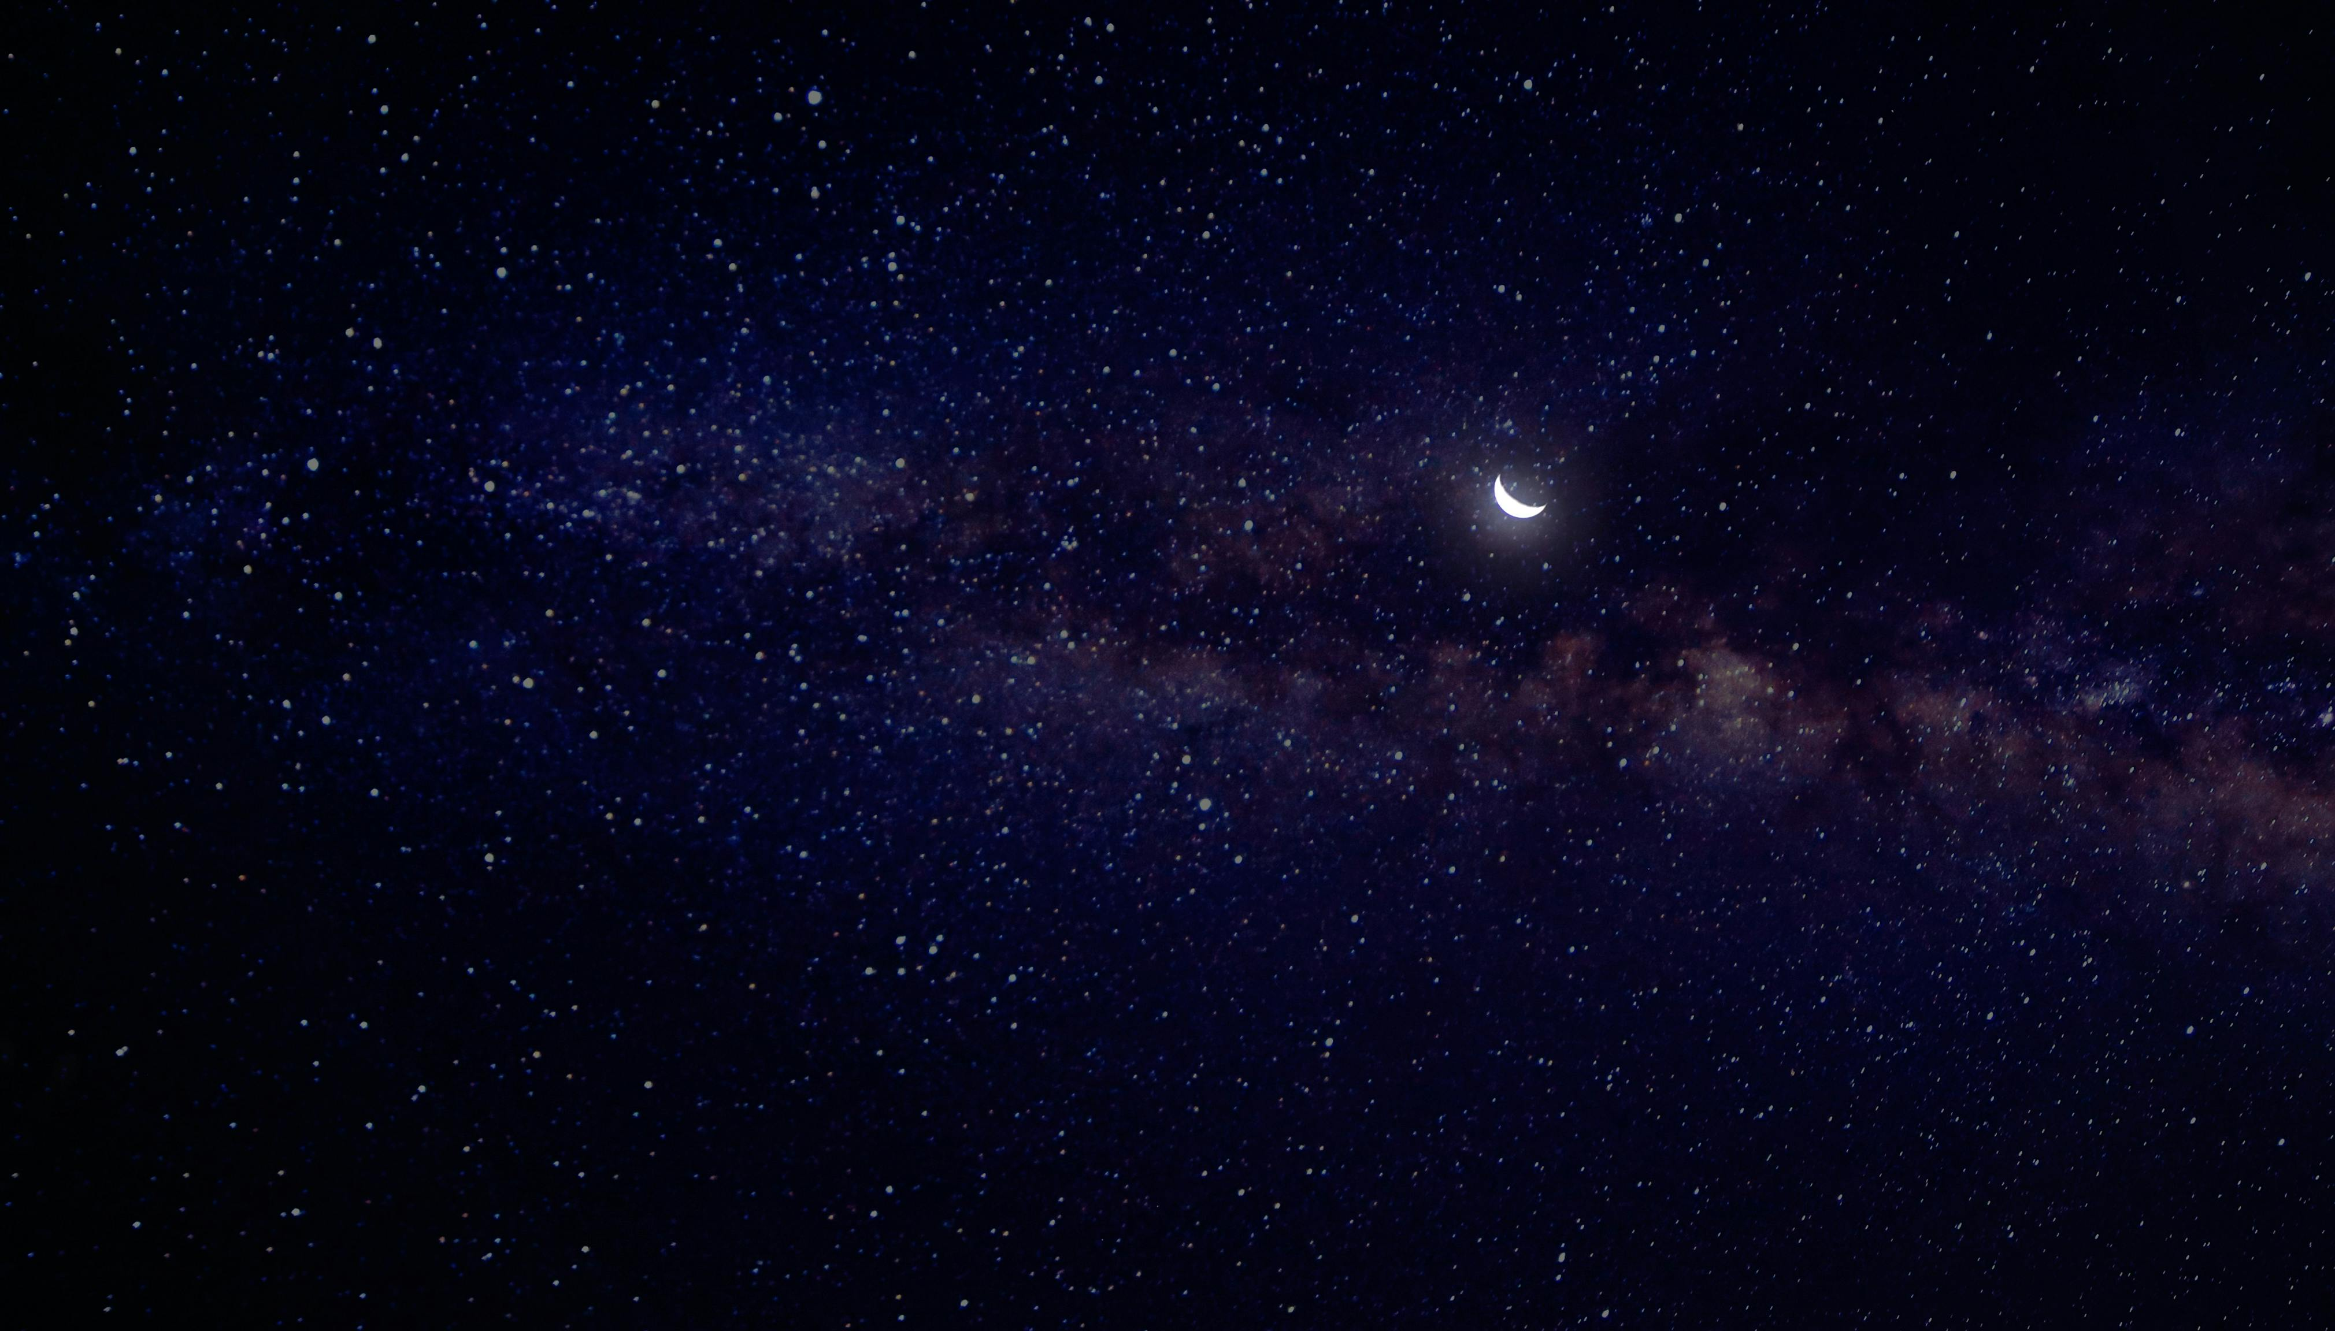
Gravitational Lens Modelling of an IllustrisTNG Mock Multiply Lensed Supernova
Rommulus Francis Lewis
Final Year Project
Supervisor: Prof Jeremy Lim

Slide 6
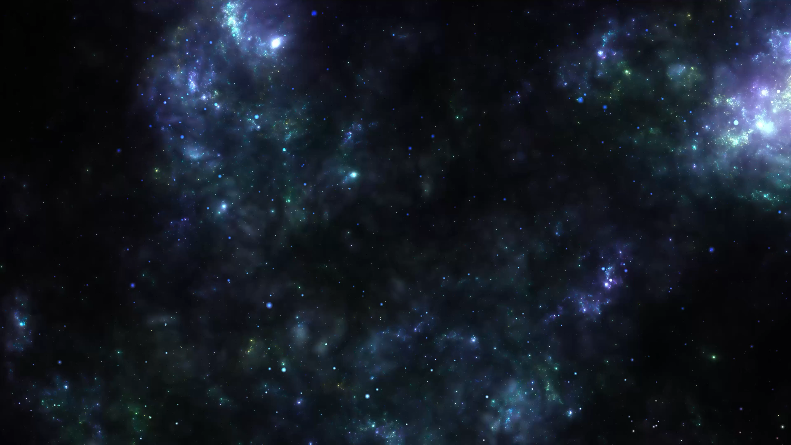
Gravitational Lens Modelling of an IllustrisTNG Mock Multiply Lensed Supernova
Rommulus Francis Lewis
Final Year Project
Supervisor: Prof Jeremy Lim

Slide 7
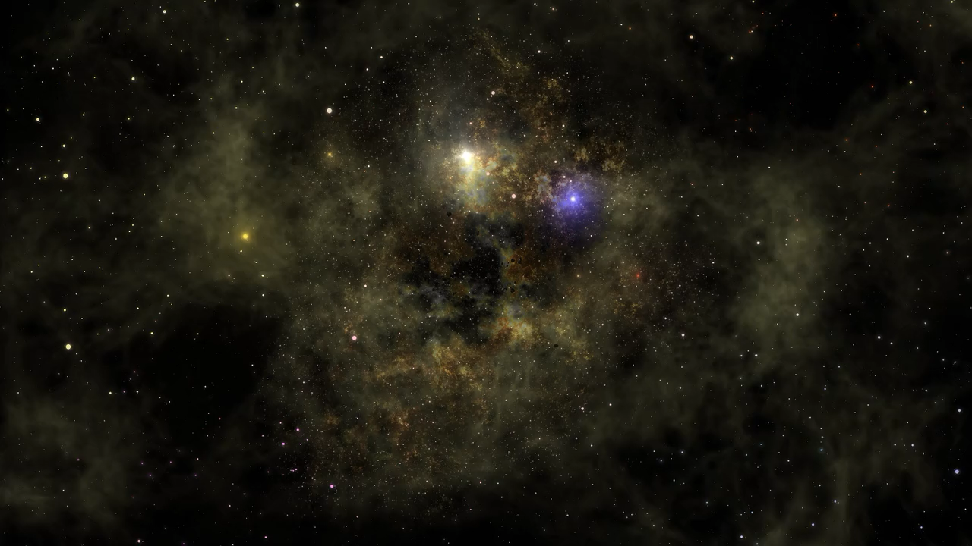
Gravitational Lens Modelling of an IllustrisTNG Mock Multiply Lensed Supernova
Rommulus Francis Lewis
Final Year Project
Supervisor: Prof Jeremy Lim

Slide 8
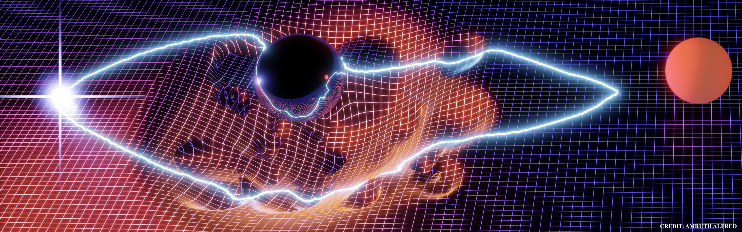
Gravitational Lensing

Slide 9
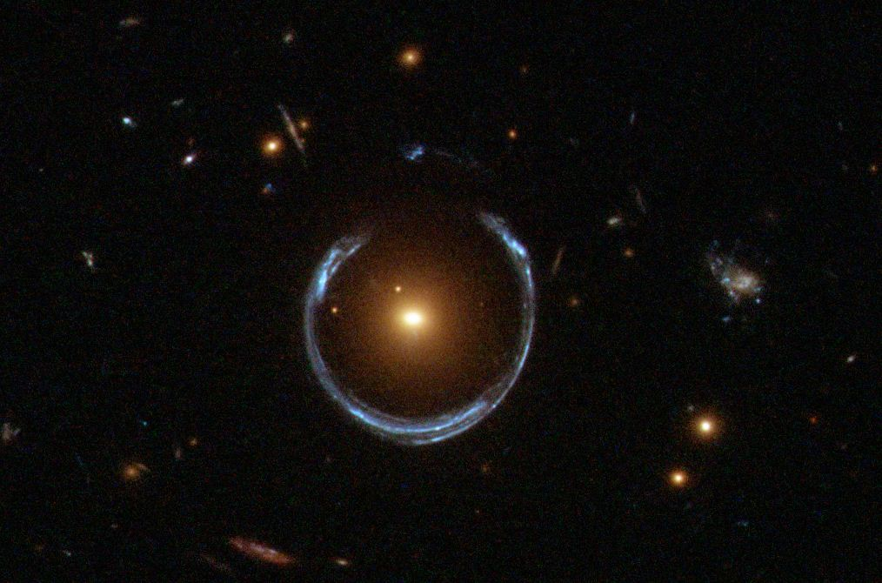
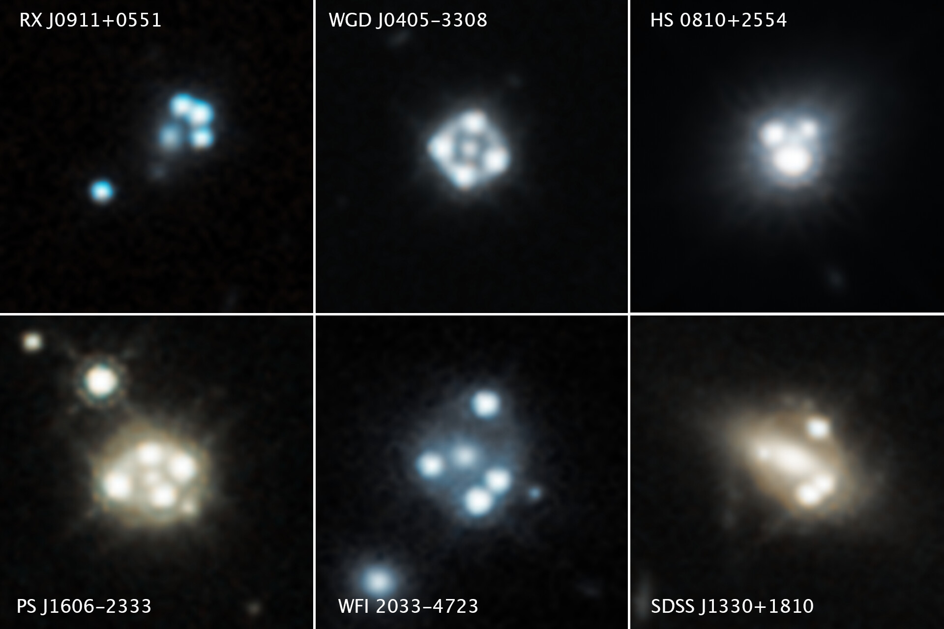
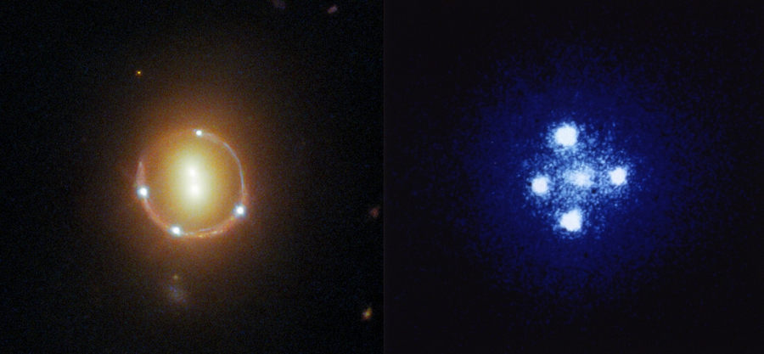
Strong Gravitational Lenses (Real Data)

Slide 10
Strong Gravitational Lenses (Real Data)
Lens Modelling
Objective:
Estimate the mass profile
of the lensing galaxy
Image Properties:
Position
Magnification
Lensing Galaxy
Lensed Image

Slide 11
Strong Gravitational Lenses (Real Data)
Lens Modelling
Objective:
Estimate the mass profile
of the lensing galaxy
Image Properties:
Position
Magnification
MATTER
ORDINARY/BARYONIC MATTER
DARK MATTER
Protons
Neutrons
Electrons
?

Slide 12
Data - Simulations
Getting the data:
Use a simulated galaxy from IllustrisTNG suite of simulations
Place a Supernova behind the galaxy
Get the lensed images
Done by Alex Chow
(MPhil at HKU)

Slide 13
Data - Simulations
Getting the data:
Use a simulated galaxy from IllustrisTNG suite of simulations
Place a Supernova behind the galaxy
Get the lensed images
Done by Alex Chow
(MPhil at HKU)
What we do:
Model the dark matter
Model the baryonic matter
Model other components (SHEAR)

Slide 14
Why Simulations
Lens Modelling
Objective:
Estimate the mass profile
of the lensing galaxy
In Real Data: Mass profile unknown
In Simulations: Mass profile is known
Lensing Galaxy
Lensed Image

Slide 15
RESEARCH QUESTION
Can Lens Modelling correctly estimate the dark matter profile of the lensing galaxy?

Slide 16
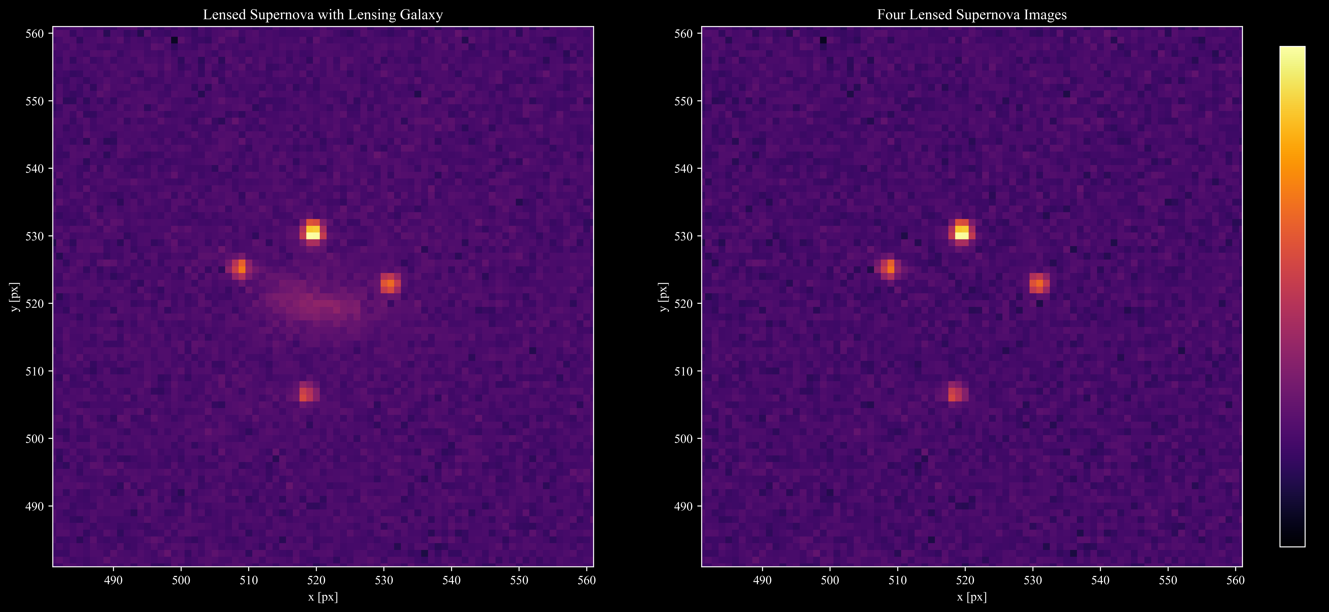
Data

Slide 17
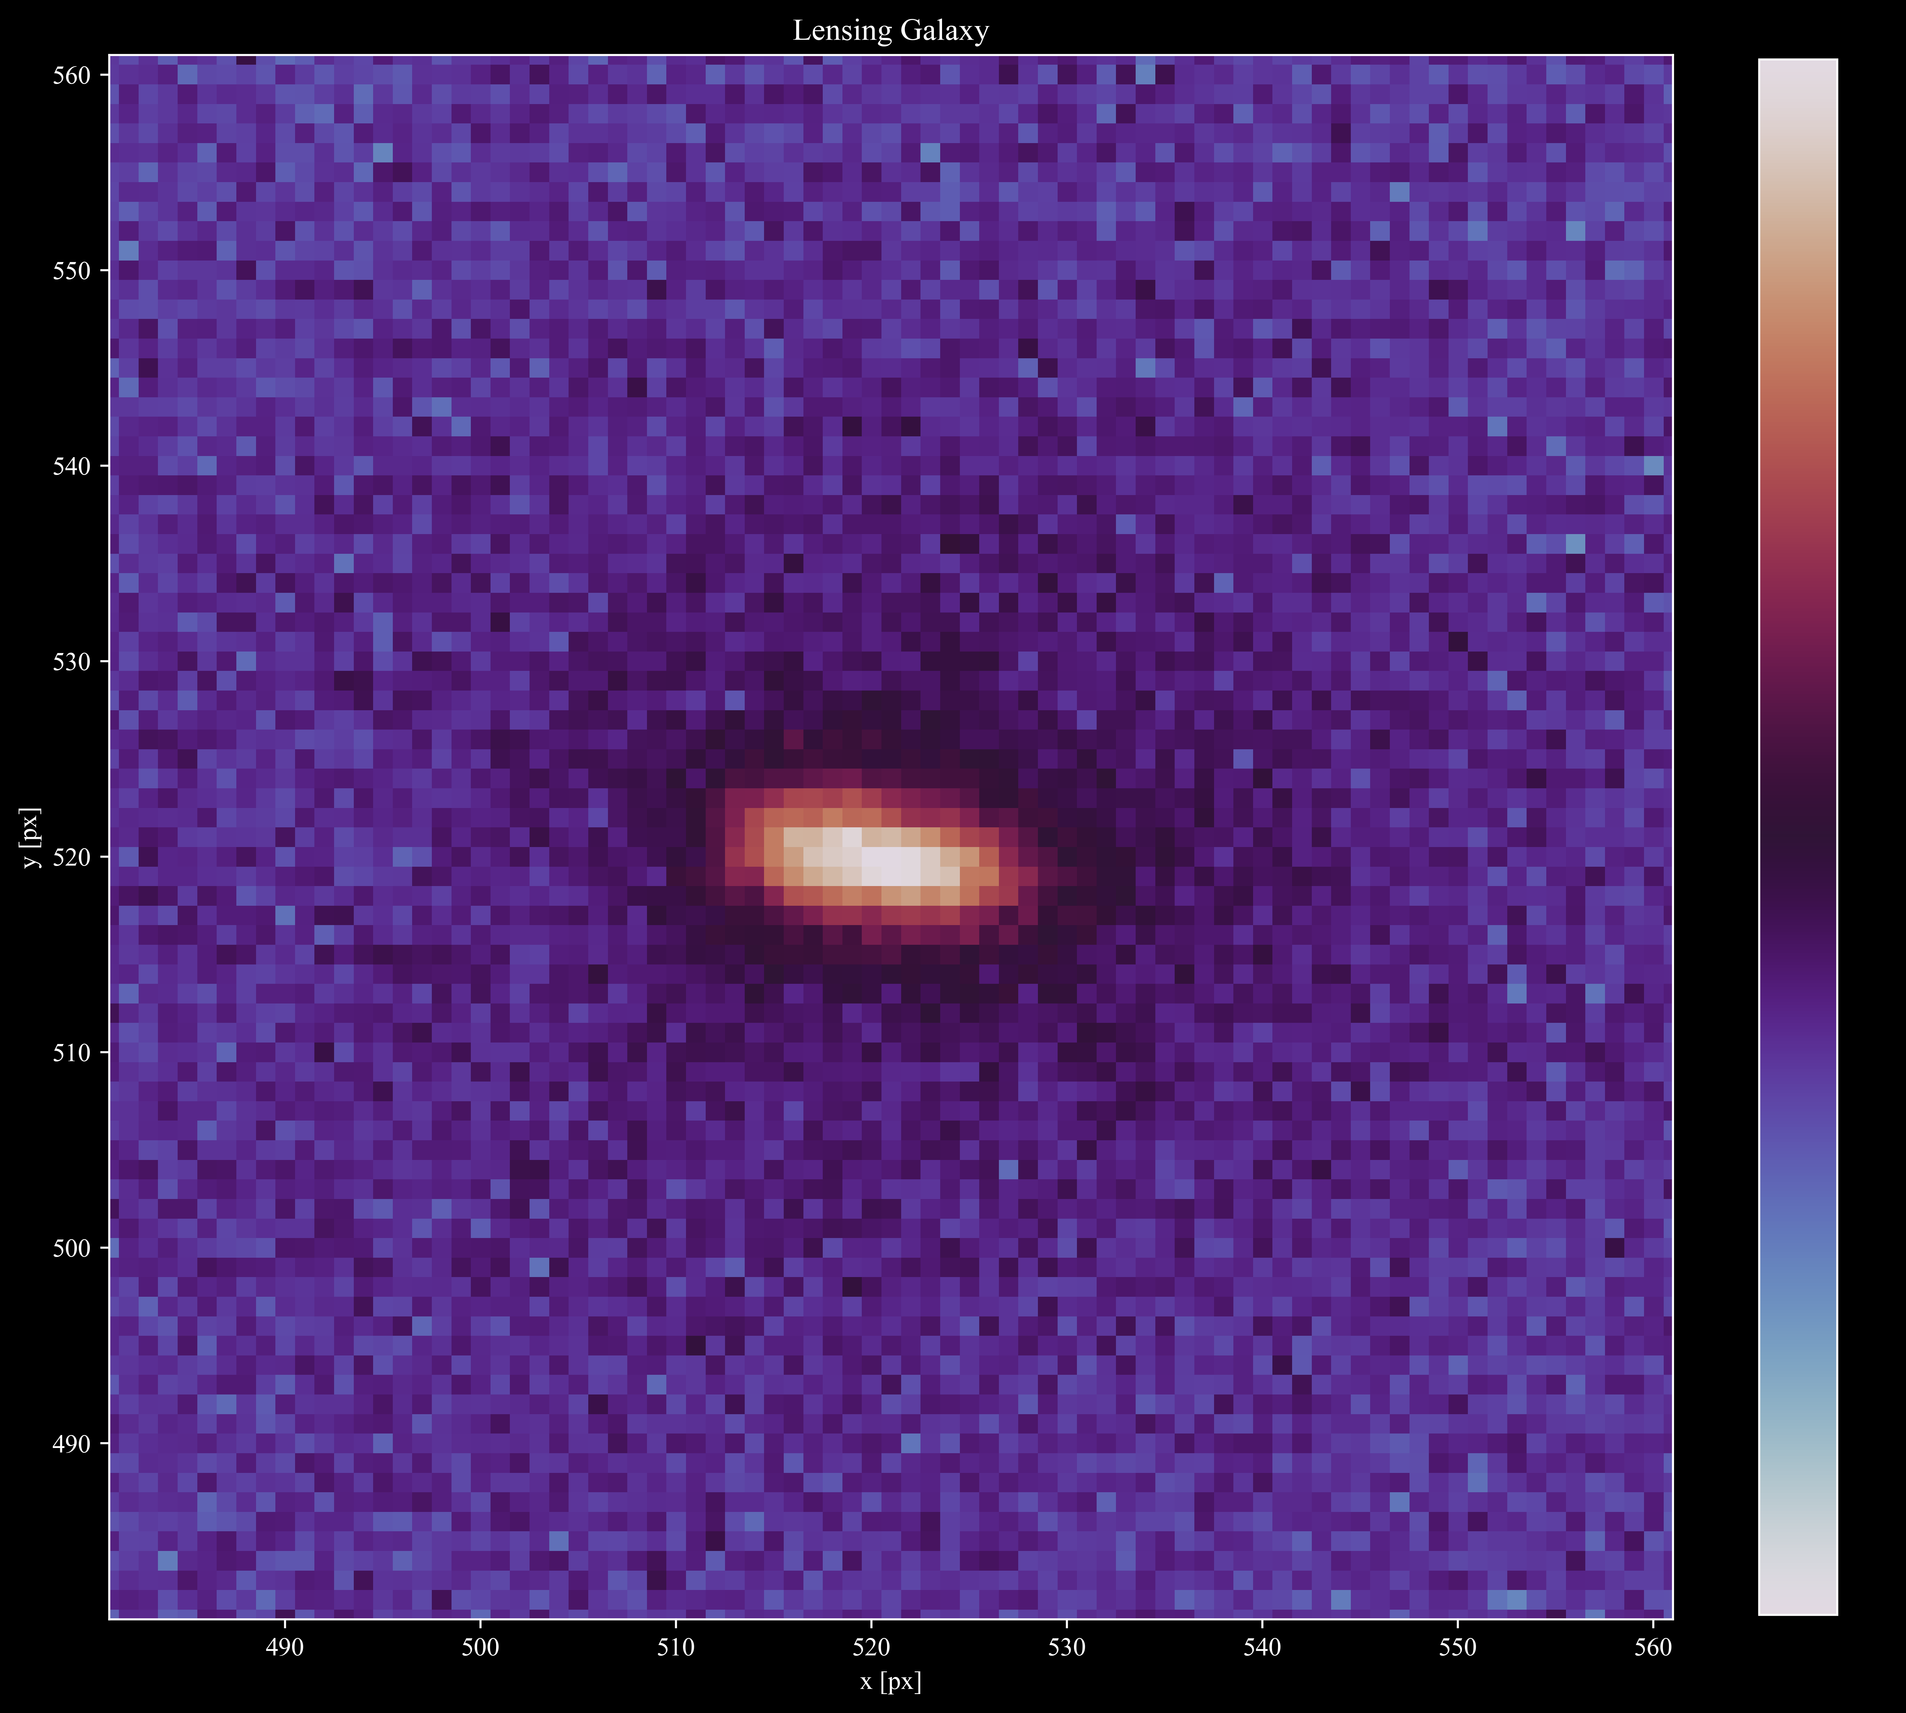
Data

Slide 18
Lens Modelling
CONSTRAINTS:
Positions
Magnifications
MASS MODELS:
Single Isothermal Ellipsoidal (SIE)
Power Law (POW)
Navarro Frenk White (NFW)
Einasto (EIN)
Cored Single Isothermal Ellipsoidal (CSIE)
Sersic (For the lensing galaxy)

Slide 19
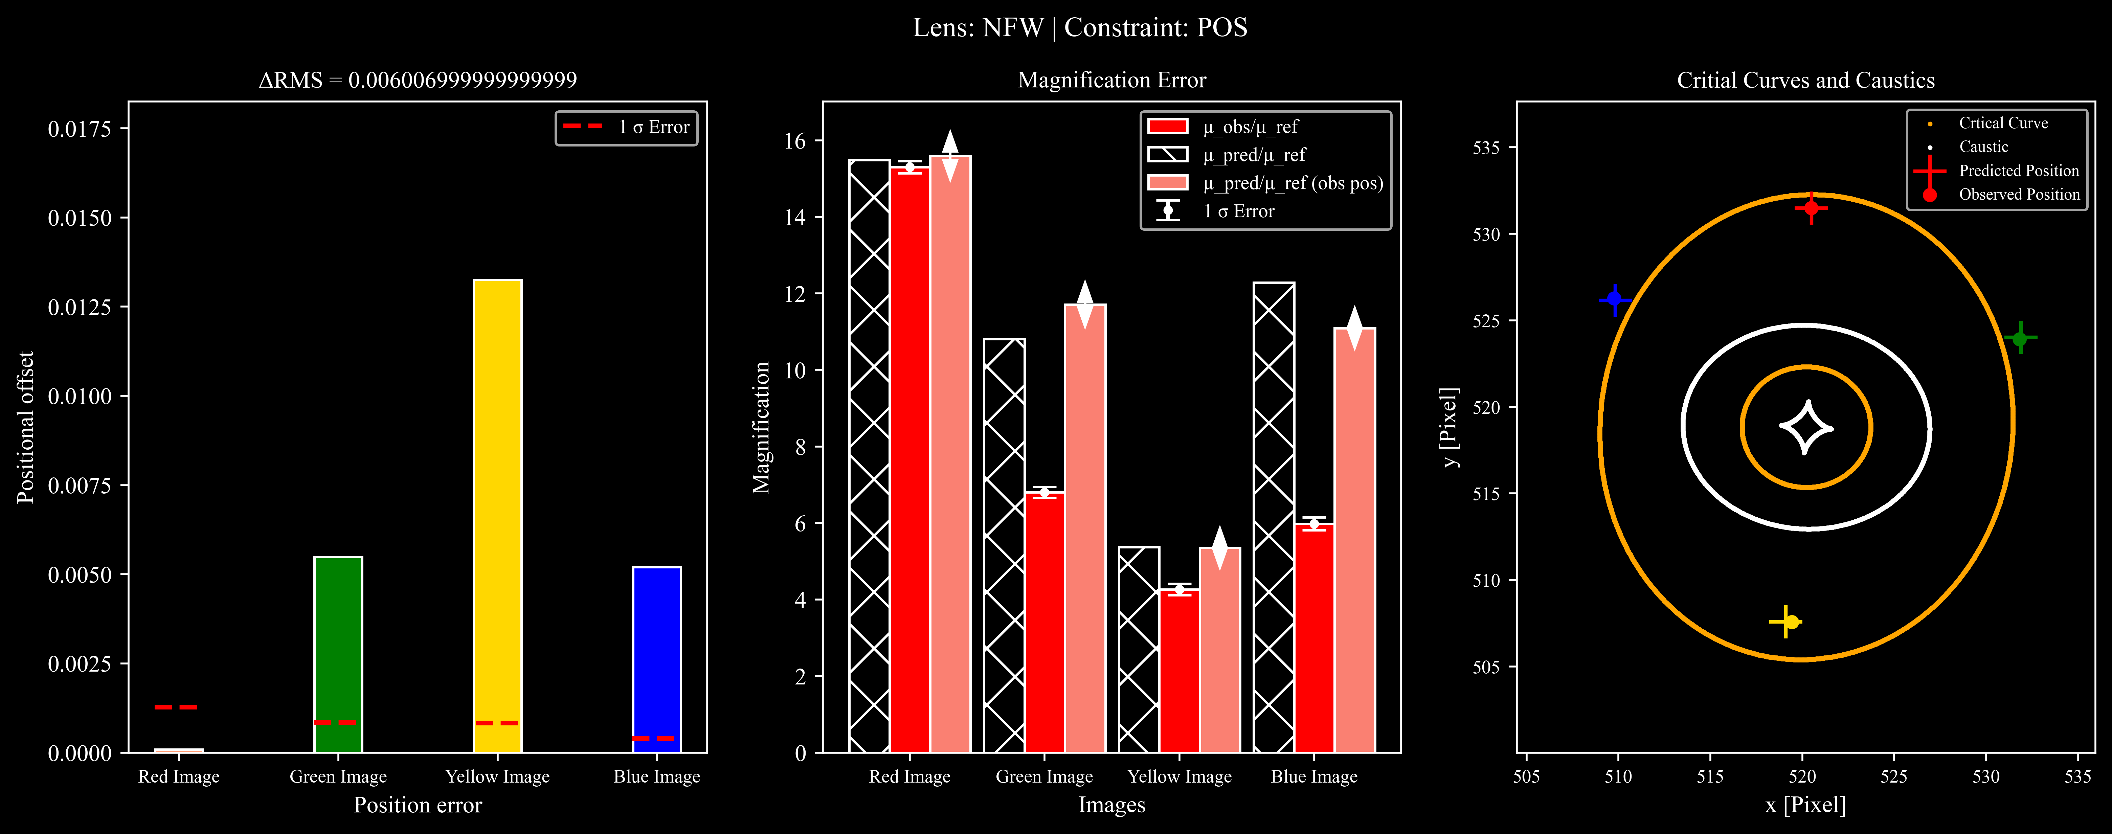
Lens Models

Slide 20
Lens Models

Slide 21
Lens Models

Slide 22
Lens Models

Slide 23

Critical Curves and Caustics

Slide 24
Cosmic Shear

Slide 25
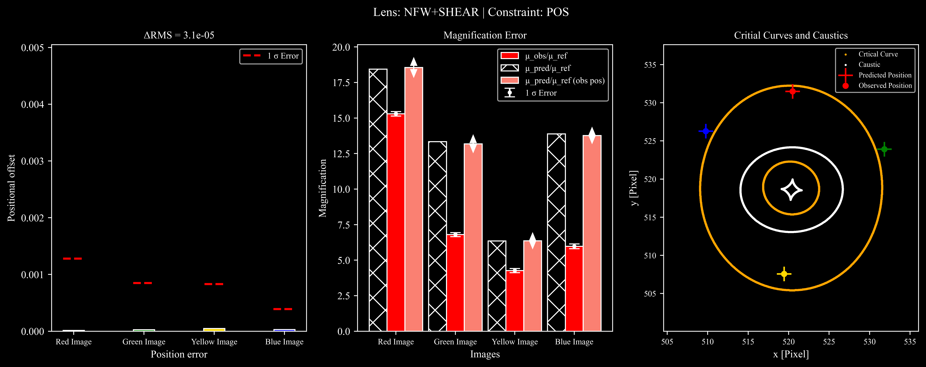
Cosmic Shear

Slide 26
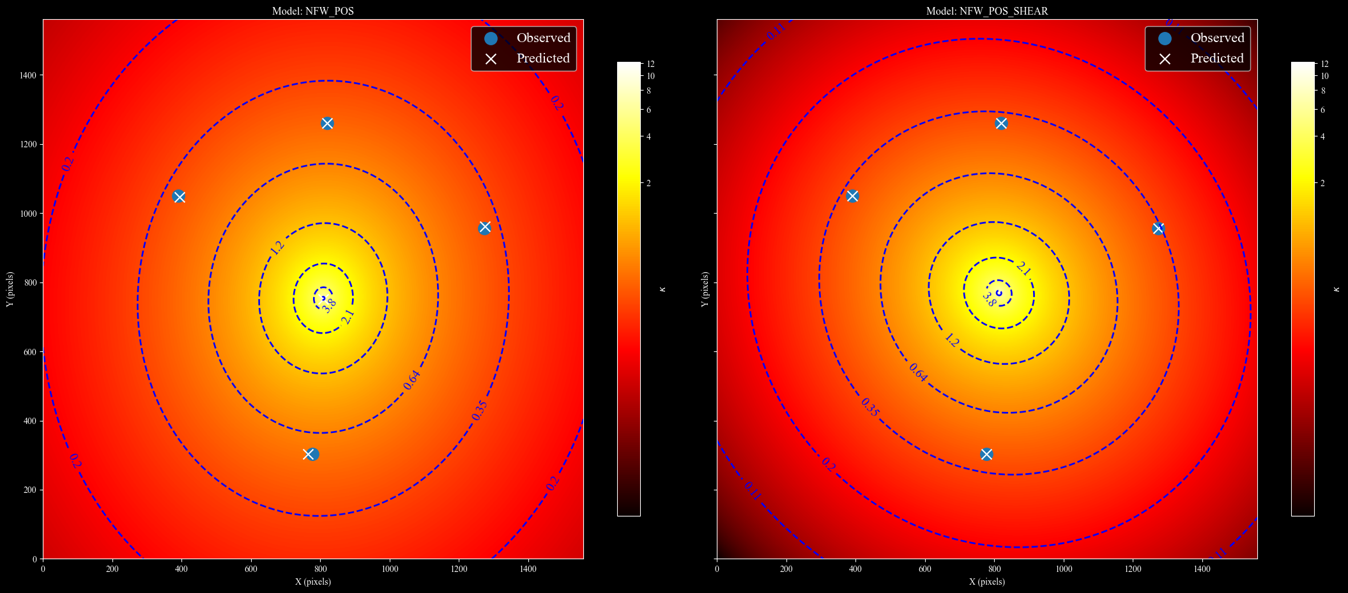
Cosmic Shear

Slide 27
Cosmic Shear

Slide 28
Cosmic Shear

Slide 29
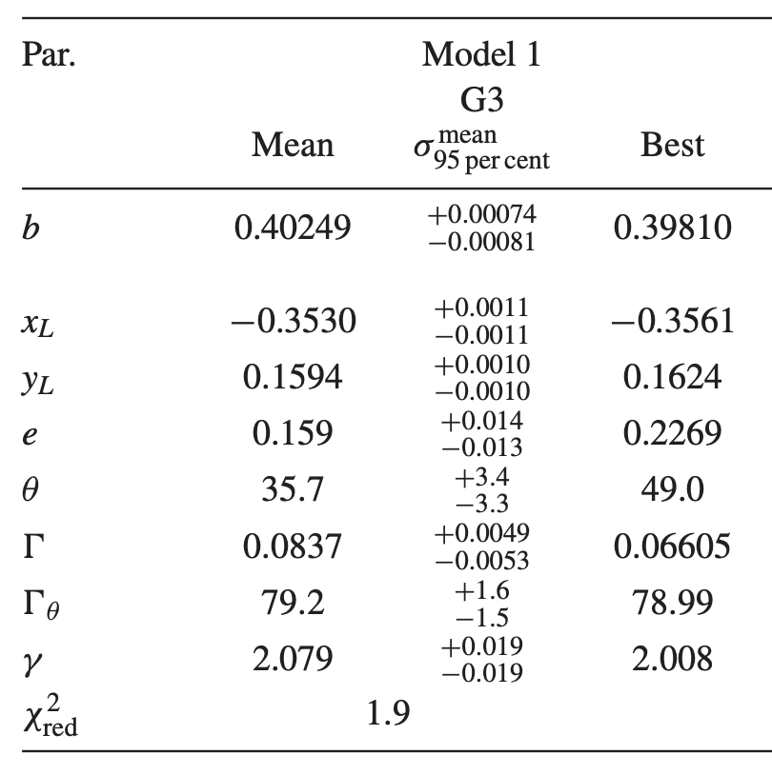
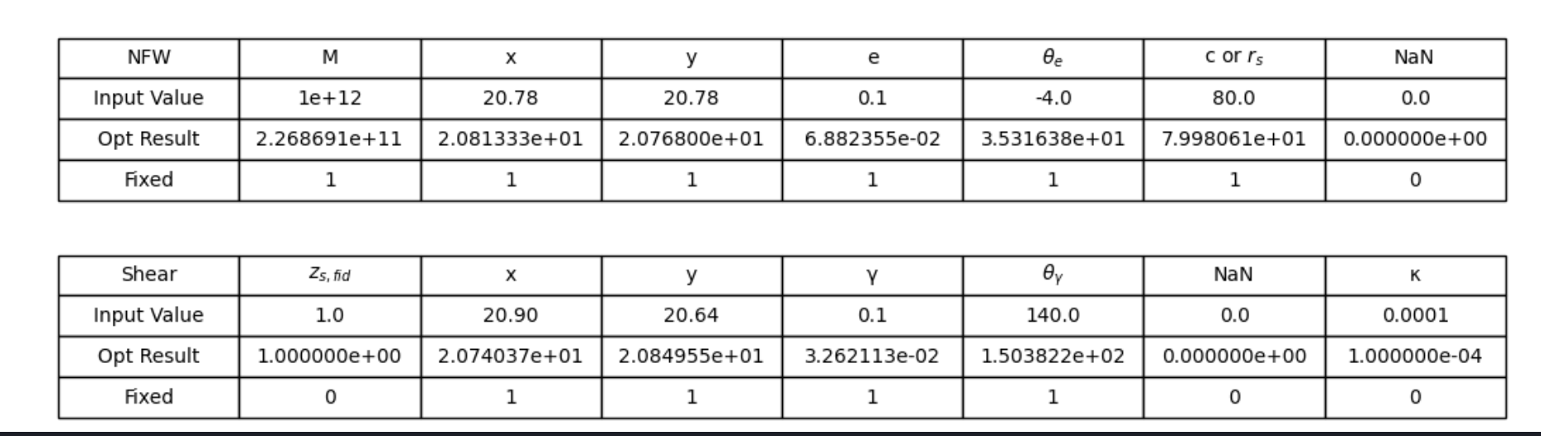
Cosmic Shear
Shear on the same order of magnitude
=
Unphysical

Slide 30
Results
2 Main Results:
None of the > 50 lens models can reproduce the positions and magnifications of all 4 images within 1 σ
Adding a shear component resolves all position anomalies but is unphysical
Interpretation
Lens modelling may inherently be inaccurate
We need a new approach to account for cosmic shear (4th Order Multipoles)

Slide 31
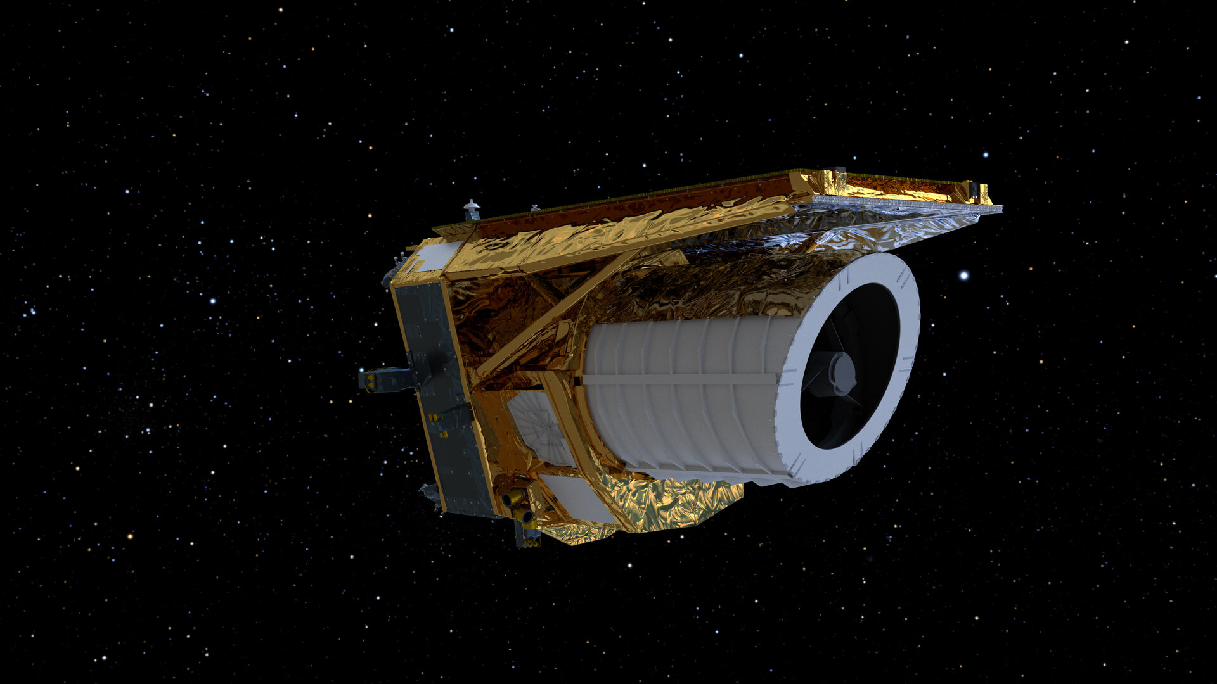
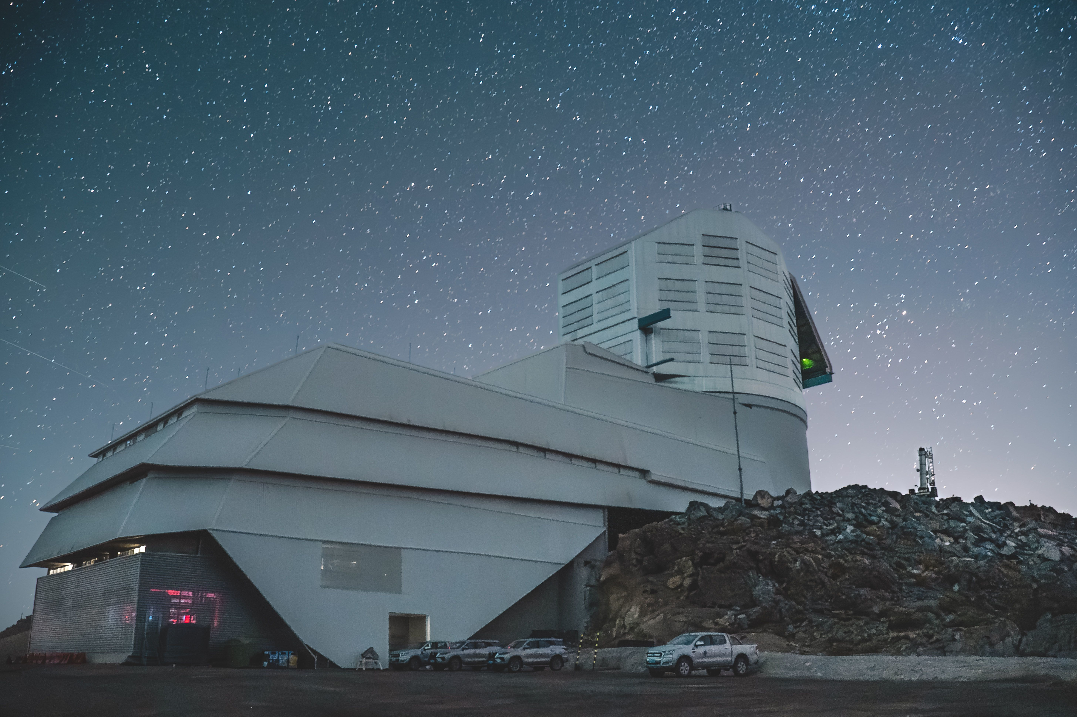
Why is this IMPORTANT?
Interpretation
Lens modelling may inherently be inaccurate
We need a new approach to account for cosmic shear (4th Order Multipoles)
Vera C Rubin Observatory expected to find > 1000 gravitational lenses
Euclid expected to find > 100,000 gravitational lenses

Slide 32
Why is this IMPORTANT?
Vera C Rubin Observatory expected to find > 1000 gravitational lenses
Euclid expected to find > 100,000 gravitational lenses

Slide 33
Future
Vera C Rubin Observatory expected to find > 1000 gravitational lenses
Euclid expected to find > 100,000 gravitational lenses

Slide 34
Why is this IMPORTANT?
What is Dark Matter?
What is the right Dark Matter Particle?
What is the right Dark Matter profile for a galaxy?
Is Lens Modelling Effective as a method to probe Dark Matter?

Slide 35
Conclusion

Slide 36
References
[1] N. Arendse, E. M¨ortsell, L. Weisenbach, E. Hayes, S. Thorp, S. Dhawan, A. Goobar, S. Guerrini, J. O. Hjortlund, J. Johansson, and C. Lemon. Microlensing of lensed supernovae zwicky iptf16geu: constraints on the lens galaxy mass slope and dark compact object fraction, 2025. URL https://arxiv.org/abs/2501.01578.
[2] D. A. Torres-Ballesteros and L. Casta˜neda. ¡scp¿relensing¡/scp¿: Reconstructing the mass profile of galaxy clusters from gravitational lensing. Monthly Notices of the Royal Astronomical Society, 518(3):4494–4516, Nov. 2022. ISSN 1365-2966. doi:10.1093/mnras/stac3253. URL http://dx.doi.org/10.1093/mnras/stac3253.
[3] C Spingola, J P McKean, M W Auger, C D Fassnacht, L V E Koopmans, D J Lagattuta, S Vegetti, SHARP – V. Modelling gravitationally lensed radio arcs imaged with global VLBI observations, Monthly Notices of the Royal Astronomical Society, Volume 478, Issue 4, August 2018, Pages 4816–4829, https://doi.org/10.1093/mnras/sty1326
Images: Horseshoe Lens : ESA/Hubble & NASA
Euclid Lenses: Euclid & ESA
Euclid Telescope: Euclid & ESA

